Slide 1
Phase 2: Data Understanding & Exploratory Analysis
Empirical inspection, statistical distributions, correlation modeling, and preprocessing of gym workout records.
Gym Exercise Tracking Dataset

Slide 2
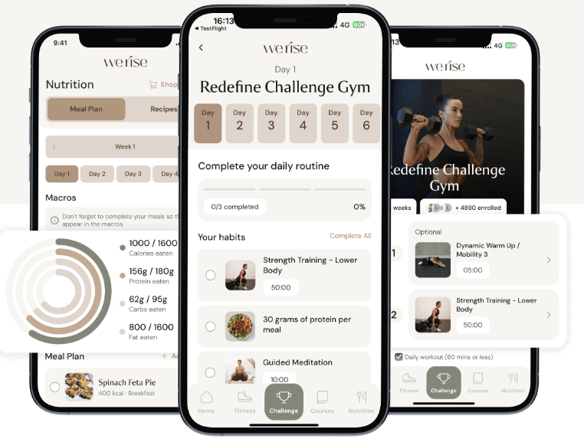
Dataset Provenance & Scope
DATA SOURCE
Kaggle / GitHub Repository
https://www.kaggle.com/datasets/valakhorasani/gym-members-exercise-dataset
COLLECTION CONTEXT
Fitness Center Member Tracking
Aggregated biometric and physiological workout metrics.
CORE OBJECTIVE
Energy Expenditure Prediction
Exploratory baselining for caloric burn modeling and training patterns.

Slide 3
Structural Profile & Target Variable
973
15
13 / 2
Total Member Records
Observed Features
Numeric vs. Categorical
TARGET CLASS IDENTIFICATION
CATEGORICAL DATA
Calories_Burned
Gender & Workout_Type
Continuous numerical regression target indicating total energy output per exercise session.
Gender (Male / Female) and Workout Type (Cardio, HIIT, Strength, Yoga) serve as key groupings.
NUMERICAL DATA
Age, Weight, Height, Max_BPM, Avg_BPM,Resting_BPM, Session_Duration, Fat_Percentage, Water_Intake, Workout_Frequency, Experience_Level, BMI

Slide 4




Detected Anomalies & Cleansing Steps
Zero Missing Values
Zero Duplicates
Unit Transformation
Z-Score Outliers
Zero null entries across all 15 columns.
973 unique tracking records confirmed.
Converted pounds and inches for modeling.
Identified extreme points exceeding |Z| > 3.

Slide 5
Numerical Attribute Outlier Distribution
Natural Physiological Spread
IQR Dispersion across 13 Numerical Dimensions
No negative, corrupt, or truncated values exist. Features like Water_Intake and Workout_Frequency sit entirely within plausible real-world ranges.
Age (18–59)
Heart Rates
Duration (0.5–2h)
Zero fliers • Symmetric
Zero fliers • Bounded
Zero fliers • Uniform
Weight (kg)
BMI (12.3–49.9)
Calories Burned
Right-Tail Outlier Drivers
1 flier at 130 kg
Dense right fliers (>41)
Upper fliers (>1600)
Upper fliers in Calories_Burned correspond strictly to maximum 2.0-hour workout sessions by high-mass individuals rather than random measurement noise.

Slide 6
Parametric Summary of Key Attributes
Feature Attribute | Data Type | Min | Max | Mean ± Std | Observed Spread
Calories_Burned (Target) | Float64 | 303.00 | 1783.00 | 905.42 ± 272.64 | Broad continuous range
Session_Duration (hours) | Float64 | 0.50 | 2.00 | 1.26 ± 0.34 | Uniform exercise window
Avg_BPM | Int64 | 120 | 169 | 143.77 ± 14.35 | Cardiovascular exertion
Fat_Percentage | Float64 | 10.0% | 35.0% | 24.98% ± 6.26% | Realistic body composition
Workout_Frequency | Int64 | 2 days | 5 days | 3.32 ± 0.91 | Days logged per week

Slide 7
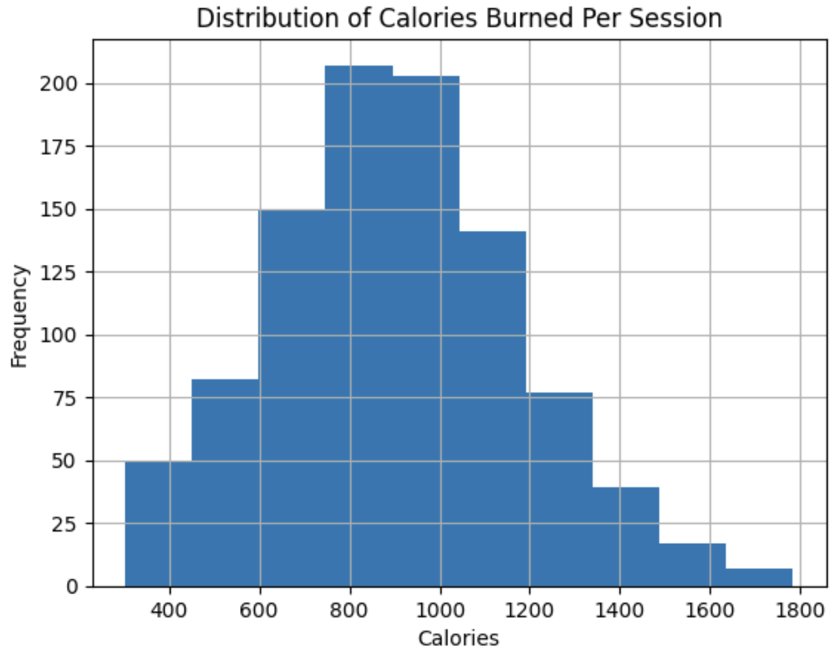
Target Distribution: Calories Burned
Binned histogram of Calories Burned across 10 equal frequency intervals (200 kcal to 1,800 kcal).
Normal distribution shape centered near 900 kcal
Slight positive right skew toward endurance workouts

Slide 8
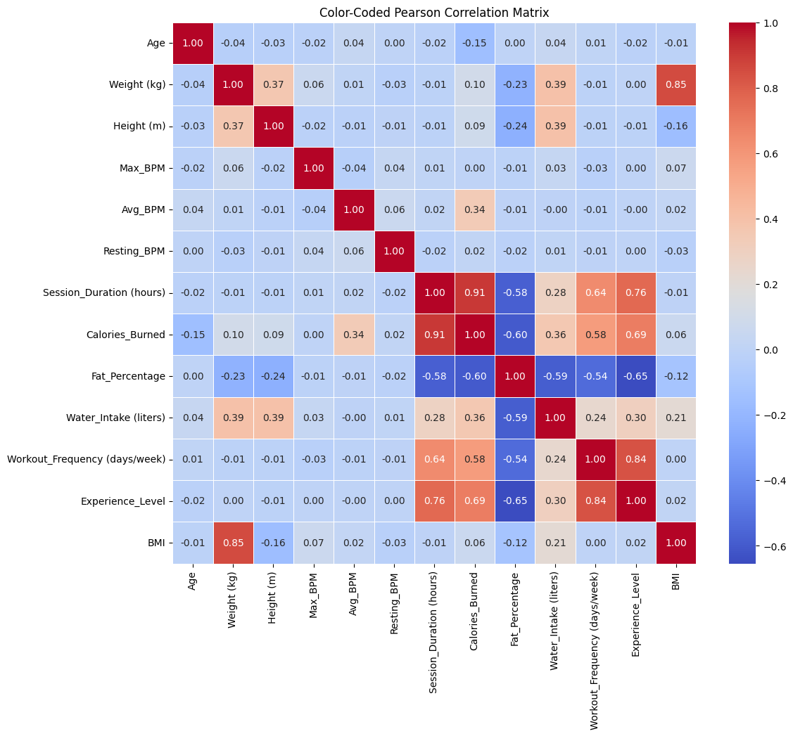
Pearson Correlation with Target (Calories Burned)

Slide 9
Pearson Correlation with Target (Calories Burned)
Session_Duration
+0.91
Experience_level
+0.69
Workout_frequency
+0.58
Average_BPM
+0.34
Fat_Percentage
-0.60
Key Takeaway: Workout duration is the primary linear predictor (r = 0.91), followed by member experience level (Experience_level = 0.69).

Slide 10
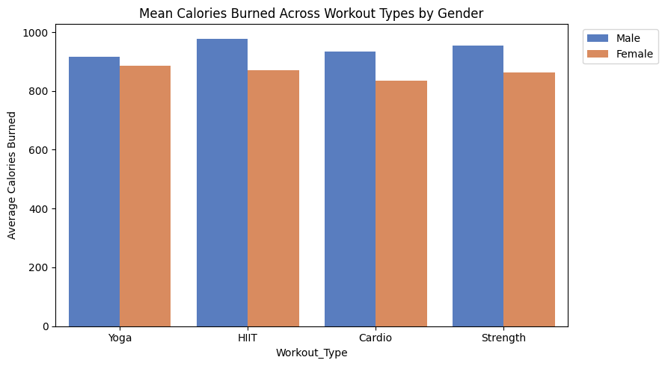
Workout Type & Gender Interactions
KEY TAKEAWAYS:
Category Ranking: HIIT (~980 kcal) and Strength (~970 kcal) yield the highest average caloric expenditure, followed by Cardio (~960 kcal) and Yoga (~900 kcal)
Gender Expenditure Differential:
  Male records average higher caloric output across all categories (~100–120 kcal delta)

Slide 11
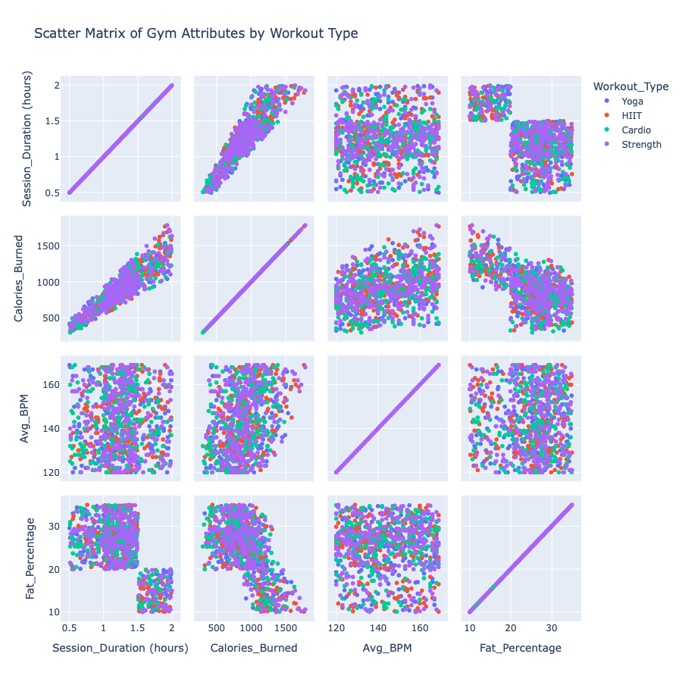
Workout Type Vs (Session_Duration, Calories_Burned, Avg_BPM, Fat_Percentage)
Scatter Matrix: Duration, Calories, Heart Rate & Fat Percentage
PRIMARY PREDICTOR ALIGNMENT: Session duration and calories burned form a direct, deterministic linear path across all four workout types
TWO DISTINCT TRAINING SUBGROUPS: Data separates cleanly into two discrete rectangular clusters when pairing session length against body fat percentage (sessions > 1.5 hrs strictly map to body fat < 20%)
EQUAL INTENSITY SPREAD: Average heart rate shows uniform distribution (120–170 BPM) without distinct separation between yoga, cardio, HIIT, or strength training

Slide 12
Equal-Width and Frequency Binning for Calories Burned
Equal-Width (pd.qcut) Calories Burned
Equal-Frequency (pd.qcut) Calories Burned
Divides in equal width.
Divides into 4 quartiles with equal record counts.
W1: 301 - 673
188 members
Q1: 302 - 720
245 members
W2: 673 - 1043
506 members
Q2: 720 - 893
242 members
W3: 1043 - 1413
240 members
Q3: 893 - 1076
243 members
W4: 1413 - 1783
39 members
Q4: 1076 - 1783
243 members
Right-skewed (positively skewed) Severe class size imbalance
Equal class size (Low, Moderate, High, Very High)

Slide 13
Supervised Learning Roadmap
REGRESSION MODELING (Predicting Exact Calories)
Goal: Predict the exact number of calories a member burns during their workout session.
Simple Baseline: Linear Regression (tests how much calorie burn increases simply as workout duration gets longer).
Advanced Models: Decision Trees, k-NN, and Neural Networks (capture complex patterns when duration, heart rate, and body fat work together).
How We Measure Success: Look at the average prediction error (how many calories off our model is on average).
CLASSIFICATION MODELING (Predicting Workout Intensity Tier)
Goal: Sort each workout into 4 clear levels: Low, Moderate, High, or Very High calorie burn.
Models to Test: Decision Trees (if/then rules), Naïve Bayes (probability), and k-Nearest Neighbors (grouping similar workouts).
How We Measure Success: Accuracy score and a confusion matrix (checking how often the model confuses adjacent tiers, like "Moderate" vs. "High").

Slide 14
Unsupervised Learning Roadmap
1. ASSOCIATION ANALYSIS (Finding Hidden Workout Habits)
Goal: Discover natural connections and co-occurring training habits across workout modalities, member experience levels, and physiological demands.
Algorithm: Apriori Algorithm (identifies frequent itemsets meeting minimum support, then extracts directional IF-THEN rules).
Candidate Association Rules Generated from Itemsets:
  Energy Expenditure: {Workout_Type = HIIT, Duration = High} -> {Calories_Burned = Very_High}
  Cardiovascular Strain: {Workout_Type = HIIT, Experience_Level = Advanced} -> {Avg_BPM = High}
  Member Progression: {Fat_Percentage = Low, Workout_Frequency = High} -> {Experience_Level = Advanced}
  Hydration Demands: {Duration = High, Avg_BPM = High} -> {Water_Intake = High}
How We Measure Success: Evaluated using Support (rule frequency ≥0.10≥0.10), Confidence (rule reliability ≥0.70≥0.70), and Lift (>1.0>1.0, proving a genuine link over random chance).

Slide 15
Unsupervised Learning Roadmap
2. CLUSTERING & ANOMALIES (Grouping Similar Members & Spotting Outliers)
Goal: Group members into natural "fitness profiles" (e.g., endurance athletes vs. casual beginners) without using pre-set labels.
Models to Test: k-Means and Hierarchical Clustering (automatically grouping members by their body stats and heart rates).
Anomaly Check: Pinpoint extreme outlier sessions (like workouts burning over 1,600 kcal) so they don't distort our findings.
How We Measure Success: Cluster quality scores (checking that members inside the same group are genuinely similar to one another).

Slide 16
Reference
https://healthyhabitsexplorer.com/my-one-year-journey-with-the-werise-app-by-senada-greca/

Slide 17
Questions?

